Slide 1


Audiometric Testing and Follow-up
Tri-Service Hearing Technician
4.2 Certification Course

Slide 2
Audiometric Testing and Follow-Up
Learning Objectives
2.5.1 Understand audiogram basics
Test types and format
Degrees of hearing
Common audiometric configurations
Significant/Standard Threshold Shift (STS)
Temporary Threshold Shift (TTS)
Permanent Threshold Shift (PTS)
2.5.2 Identify problem audiograms requiring review by the Professional Supervisor
2.5.3 Baseline re-establishment
Tri-Service Hearing Technician 4.2 Certification Course

Slide 3
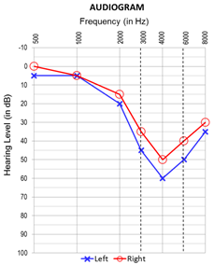

Audiometric Testing and Follow-Up
Pure Tone Air Conduction Threshold Testing
Tri-Service Hearing Technician 4.2 Certification Course
Notes:
Review Symbols/Graphic/Serial audiograms

Slide 4
Audiometric Testing and Follow-Up
Definitions
Threshold of hearing
  The lowest level of sound a person can hear in a series of ascending, pure tone presentation trials at least 50% of the time
Audiometric Zero (0 dB HL)
  The sound pressure level at which the threshold of audibility occurs for average normal listeners
Audiogram
  A record of an individual’s hearing sensitivity
  For occupational testing, a record of the pure-tone air-conduction hearing threshold levels
Normal Hearing
  Audiometric threshold results that range from -10 to 25 dB
Tri-Service Hearing Technician 4.2 Certification Course

Slide 5
Hearing Conservation Overview
Definitions
Significant/Standard Threshold Shift (STS)
  An average change of plus or minus 10 dB at 2000 Hz, 3000 Hz, and 4000 Hz, relative to the reference audiogram, in either ear, without age corrections (DoDI 6055.12)
Temporary Threshold Shift (TTS)
  An STS that resolves on follow-up test after auditory rest (≥14 hours)
Permanent Threshold Shift (PTS)
  An STS that doesn’t resolve on follow-up testing after auditory rest (≥14 hours)
  Validated by an audiologist, otolaryngologist or physician (Professional Supervisor)
Early Warning Shift (EWS)
  A difference of plus 15 dB at 1000 Hz, 2000 Hz, 3000 Hz or 4000 Hz, relative to the reference audiogram, in either ear, without an STS
  If an STS is present in the same ear, the STS takes precedence
Tri-Service Hearing Technician 4.2.0.0 Certification Course
Notes:
All STS/EWS require patient signature on the DD Form 2216

Slide 6

Audiometric Testing and Follow-Up
Audiometry Testing
Comply with Federal, DoD and Service specific regulations
Monitor the effectiveness of the local hearing program
Identify significant threshold shift(s) in hearing level
Process medical referrals for proper diagnoses
Establish individual’s fitness for duty
  Completed by Professional Supervisor
Tri-Service Hearing Technician 4.2 Certification Course
Notes:
Image: Defense Imagery Digest www.defenseimagery.mil

Slide 7
Audiometric Testing and Follow-Up
Audiometric Monitoring
Purpose: conduct routine hearing tests to identify changes in hearing related to noise exposure
Creation of initial baseline hearing thresholds
  DD Form 2215 required for all military and all those DoD civilians exposed to hazardous noise (HCP Stressors)
Determine disposition, referral needs and fitness for duty
Baseline re-establishment
Termination - removal from the HCP
Tri-Service Hearing Technician 4.2 Certification Course
Notes:
Reference audiogram - required of all military, and civilian personnel in the HCP; obtained during first 30 days of employment.
DD 2216 – Annual, Required of all military and civilian personnel routinely exposed to noise, and all Army/USMC military; enrollment in HCP.
DD 2216 current test compared to reference audiogram to determine if a change (STS) has occurred.

Slide 8
Audiometric Testing and Follow-Up
Audiometric Testing
Service members are at a much greater risk for noise-induced hearing loss compared to the general population
Noise-induced hearing loss is a bloodless/painless injury
Hearing tests are a reliable way to identify a Noise-induced injury
Early identification is the goal
  Enables access to preventive/rehabilitative services
Limits permanent impact on career/job performance
Tri-Service Hearing Technician 4.2 Certification Course

Slide 9
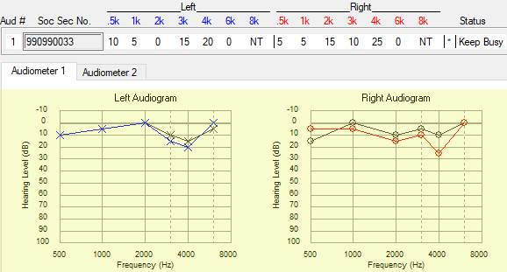
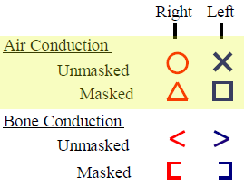
Audiometric Testing and Follow-Up
Audiogram - Graphic
Graphic representation of hearing thresholds
  Frequency and Intensity
Symbols to represent right/left ear, bone conduction and masked thresholds (legend)
  Frequently used in a clinical/diagnostic setting
Thresholds are measured and recorded in 5 dB increments
Tri-Service Hearing Technician 4.2 Certification Course
Notes:
In student database, 990990033

Slide 10
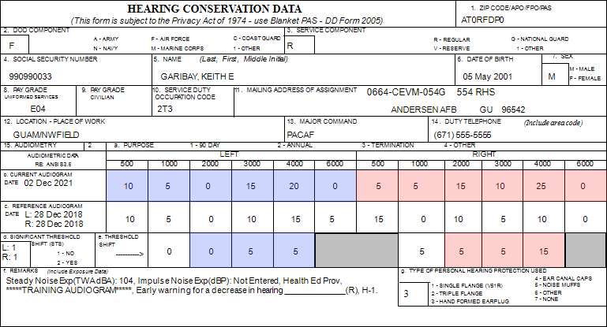
Audiometric Testing and Follow-Up
Audiogram – Serial or Numeric
DD Form 2215 (Reference Audiogram)
DD Form 2216 (Hearing Conservation Audiogram)
Non-Hearing Conservation Form (NHC)
Notes:
All Forms are located in an additional packet
Non-Hearing Conservation Form does not have a form number – used for personnel that are not in the HCP: pre-employment, non-DoD employees or not associated with DoD

Slide 11
[SSN = 990990033] Confirm demographic fields 2 thru 14 (page 67)
Is there a change in hearing (ear specific)?
Are thresholds within the range of normal (ear specific)?
Where does the patient need to go?
Additional Comments?
Tri-Service Hearing Technician 4.2.0.0 Certification Course
Notes:
Do a brief review of counseling; have patient confirm their data in demographic fields 2 thru 14.
Is there a change in hearing? EWS patient needs to sign DD Form 2216; noise notch, review and have patient put in HPDs
Are thresholds within the range of normal? Yes
Where does the patient need to go? Return in a year
Additional Comments
Have students write responses in their training booklet

Slide 12
Audiometric Testing and Follow-Up
Required DOEHRS-HC Audiogram Fields/Sub-Fields
Examiner information - previously entered/saved by technician
  Comes from user logged into DOEHRS-HC
  Name, certification number, SDOC, office symbol
Date/Time of test
  Auto entered from date/time on computer
Audiometer - previously entered/saved by technician
  Auto created from calibration baseline/saved audiometer
  Model, Make, Serial Number, Calibration date
  Type - microprocessor (Technician/automated) or manual (Audiologist)
Tri-Service Hearing Technician 4.2 Certification Course

Slide 13
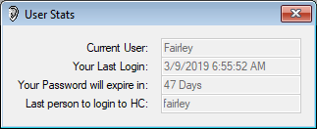
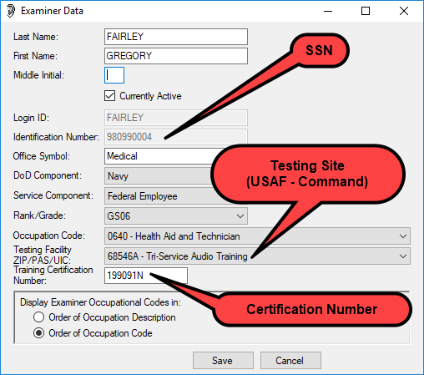
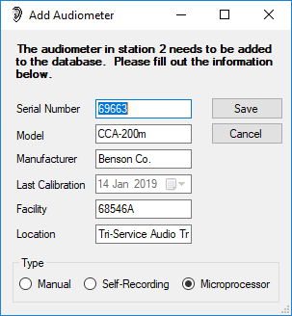
Audiometric Testing and Follow-Up
DOEHRS-HC Audiogram Sub-Fields
Examiner key fields (logged in user)
Audiometer (saved/created with calibrations)
Tri-Service Hearing Technician 4.2 Certification Course
Notes:
SSN is always inputted as the Identification number; SSN/Certification number linkage has to be correct.

Slide 14
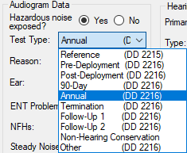
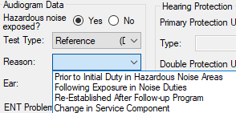
Audiometric Testing and Follow-Up
Learning Objectives
Very important that the technician select the correct test type
  Correct test type selection will ensure valid patient counseling/education/training
Test type changes once records has been exported to the DR cannot be locally accomplished
Tri-Service Hearing Technician 4.2 Certification Course
Notes:
Review of the test types are on the following slides; ensure students understand they need to know when to do what type of test.

Slide 15
Audiometric Testing and Follow-Up
DD Form 2215 Reference (Baseline) Audiogram
Required for all military and hazardous noise exposed civilians
  Patient must be 14 hours hazardous noise-free
  Should be obtained prior to noise exposure, but at least within 30 days of employment
  No Ear, Nose and Throat (ENT) problems the day of the test
OSHA allows 6 months and up to 1 year, if using a mobile testing service
Reference required (comparison) for all periodic exams (DD Form 2216 tests)
Referral may be generated depending on the threshold results and reference reason
Tri-Service Hearing Technician 4.2 Certification Course
Notes:
OSHA requires use of hearing protection at 85 dBA TWA until a baseline is obtained; once baseline is obtained, exposure level for required HPD use increases to 90 dBA TWA. If a referral is generated by test selection you may not want to create the 2215, examples: Low frequency hearing loss (conductive issues) or asymmetry, masking requirement is present (possible invalid thresholds)

Slide 16
Audiometric Testing and Follow-Up
Reference Test Selection Reasons
Prior to initial duties in noise hazardous areas
  No previous DOEHRS-HC electronic reference
  Type 1 (< 30 days hazardous noise exposure)
Following exposure in noise duties
  No previous DOEHRS-HC electronic reference
  Type 2 (> 30 days hazardous noise exposure)
Change in service component (break or change in service)
  Has a previous DOEHRS-HC electronic reference present
  Type 4 (over rides previous references – future 2216 test will compare to this)
Type 0 (non-2215) is manually entered in the run test window if DOEHRS-HC DR is down or at a non-internet connected testing site
Tri-Service Hearing Technician 4.2 Certification Course
Notes:
These are the only selections a technician may make in the DOEHRS-HC Run Test window

Slide 17
Audiometric Testing and Follow-Up
Reference Test Selection Reasons
Very important that the technician selects the correct reason when a 2215 test type is conducted
All future 2216 tests will compare to the earliest electronic reference audiogram within DOEHRS-HC
  Only type 3 or 4 reference audiograms can over-ride this application policy
Reason type 1 or 2 tests are completed as the initial reference for all military personnel or civilians in the HCP
  No previous DOEHRS-HC reference present
Tri-Service Hearing Technician 4.2 Certification Course

Slide 18
Audiometric Testing and Follow-Up
Reference Test Selection Reasons
Re-established after follow-up program
  Never selected from the Run Test window
  STS identified on preceding test series
  Follow-up 2 completed
  Type 3 (over rides previous references - ear specific)
  Reviewed and authorized by the Professional Supervisor (previous audiogram)
  Evaluated by an audiologist and manually entered into DOEHRS-HC
  All type 3 reference audiograms require an electronic remark that includes who authorized re-establishment for previous test selection or who manually entered the re-establishment
Tri-Service Hearing Technician 4.2 Certification Course
Notes:
Re-enforce an electronic remark for all type 3 re-establishments; re-established per… or input by if transcribing results from an audiologist evaluation

Slide 19
Audiometric Testing and Follow-Up
Reference Test Selection Reasons
Technician is required to make a decision on the test type and/or reason
Has to be knowledgeable on selection to negate future testing data errors
Data may be transferred to medical readiness applications
Tri-Service Hearing Technician 4.2 Certification Course
Notes:
If the wrong reference test reason is selected, future 2216 tests may not be compared to the correct 2215

Slide 20

Audiometric Testing and Follow-Up
DD Form 2216 Monitoring Audiogram Types
All requires a reference audiogram for comparison
Annual
Pre and Post-Deployment
Termination
90 Day
Other
Follow-up 1 and 2 (STS on previous test/Ear specific)
  Required within Follow-up testing timeline
Tri-Service Hearing Technician 4.2 Certification Course
Notes:
Images: Defense Imagery Digest www.defenseimagery.mil
Review when to do each type of 2216
Follow-up 1 or 2 are the only 2216 tests that can be single ear; requires STS on previous test within follow-up time frame

Slide 21
Audiometric Testing and Follow-Up
DD Form 2216 Selection
Selection of a 2216 test type requires a reference audiogram
Identifies STS/EWS and referral criteria
STS/EWS require patient signature on the 2216
  STS needs to return for Follow-up testing
If a reference audiogram is not in the local database, a type 0 reference is required to be entered in the run test window
  Type 0 reference is only transcribed from a DD Form 2215
  Date and thresholds are entered for a current test (2216) comparison
  Never transcribe from a physical, Non-Hearing Conservation test (NHC) or Military Entrance Processing Station (MEPS) audiogram
If connected to the internet and DOEHRS DR is accessible, ensure patient SSN is correct
Tri-Service Hearing Technician 4.2 Certification Course
Notes:
Technician has to be knowledgeable on test selection to negate future testing data errors

Slide 22
Audiometric Testing and Follow-Up
DD Form 2216 Selection
Hazardous Noise Exposed selection will prohibit some test selections
Tri-Service Hearing Technician 4.2 Certification Course
Notes:
Clicking yes or no to Hazardous Noise exposure limits future test type selections.

Slide 23
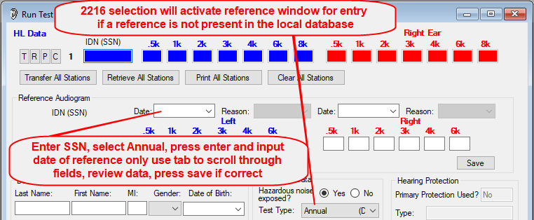
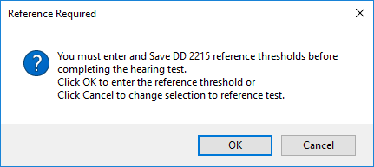
Audiometric Testing and Follow-Up
Reference Audiogram Type 0
Do not use the calendar function
Tab to go to the next field
Verify all information prior to saving
Tri-Service Hearing Technician 4.2 Certification Course
Notes:
If students have a DD Form 2215, enter their own SSN, select test type of annual and enter their own reference audiograms
Ensure when entering type 0 reference data, do not use the calendar function, it will enter a time stamp from the local computer
Use the tab to go from one date field to the other or the date may change between ears
Verify all information prior to saving type 0 reference

Slide 24
Audiometric Testing and Follow-Up
STS Identified - Follow-up Testing
Follow-up testing can only occur
  If a +/- STS occurred on the initial 2216 test
  If a + STS occurred on the Follow-up 1 test
  Follow-up testing window has not expired
Only the most recent test results remarks will be reflected on the 2216
Negative STSs do not have a noise-free requirement
Positive STSs have a 14 hour hazardous noise-free requirement
If a positive and a negative STS exists, check headphone placement/auditory history
Tri-Service Hearing Technician 4.2 Certification Course

Slide 25
Audiometric Testing and Follow-Up
Negative STS Follow-up Testing
Thresholds are better than the reference
  Normally occurs early in the audiometric history
Review the audiometric summary
  Was the baseline recent or re-established by an audiologist
  Is there a masking requirement
If the reference is possibly invalid immediately re-test the ear that had the negative STS
  If the negative STS is validated on follow-up 1, software will re-establish the baseline (ear specific)
Tri-Service Hearing Technician 4.2 Certification Course

Slide 26
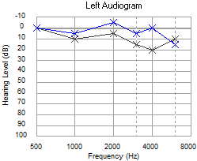
Audiometric Testing and Follow-Up
Negative STS Initial 2216 Test
Negative STS was identified on the initial 2216 test [SSN = 990990001]
Review audiometric history
  Note first 2216 test after reference generated
Retest if initial 2215 may be invalid
Tri-Service Hearing Technician 4.2 Certification Course
Notes:
Have students bring up audiometric history in the edit audiogram window; if a re-establishment is not warranted, do not do the Follow-up test.

Slide 27
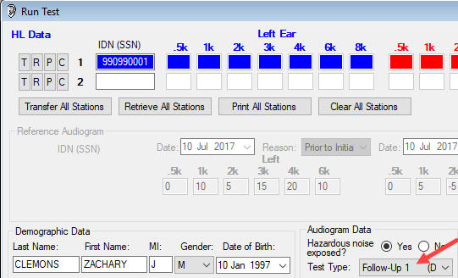
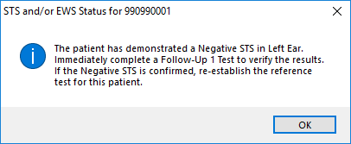
Audiometric Testing and Follow-Up
Negative STS Follow-up Test
Clear Run Test station after initial 2216 test
  Input SSN
  Follow-up 1 test will be auto-selected
  Retest ear that had the STS
Tri-Service Hearing Technician 4.2 Certification Course

Slide 28
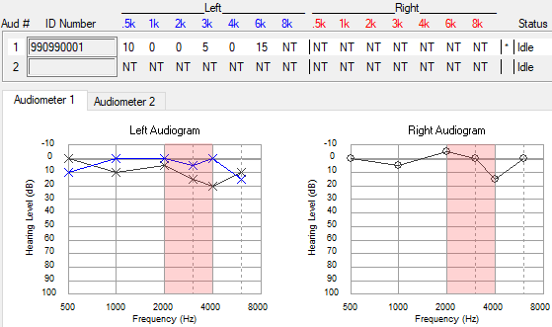
Audiometric Testing and Follow-Up
Negative STS Follow-up Testing Confirmed
Tri-Service Hearing Technician 4.2 Certification Course
Notes:
Negative STS still present

Slide 29
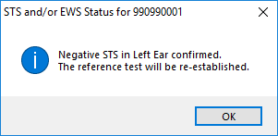
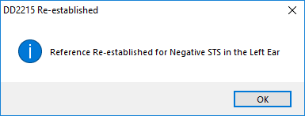
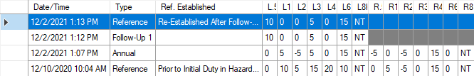
Audiometric Testing and Follow-Up
Run Test Retrieval on Follow-up 1
If the negative STS is confirmed on the Follow-up 1 retrieval into the Run Test window will auto re-established the baseline
Tri-Service Hearing Technician 4.2 Certification Course
Notes:
In student database, 990990001, Annual identifies negative STS left ear; follow-up 1 confirms the negative STS; baseline for left ear automatically re-established 1 minute post test series.

Slide 30
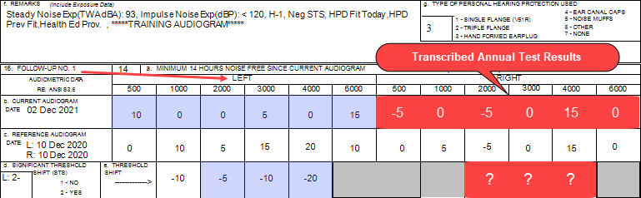
[SSN = 990990001] Confirm demographic fields 2 thru 14 (page 71)
Is there a change in hearing (ear specific)?
Are thresholds within the range of normal (ear specific)?
Where does the patient need to go?
Additional Comments?
Tri-Service Hearing Technician 4.2.0.0 Certification Course
Notes:
Do a brief review of counseling; have patient confirm their data in demographic fields 2 thru 14.
Is there a change in hearing? Negative STS Left ear; Baseline re-established
Are thresholds within the range of normal? Yes
Where does the patient need to go? Return in a year; future tests will compare to the new left ear baseline
Additional Comments
Have students write responses in their training booklet

Slide 31

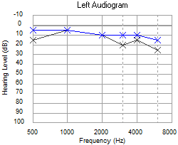
Audiometric Testing and Follow-Up
Negative STS Follow-up Testing Resolved
Negative STS was identified on the initial 2216 test [SSN = 990990017]
STS resolved on Follow-up testing
Tri-Service Hearing Technician 4.2 Certification Course
Notes:
Student can look at data in their own database, viewing the 990990017 DD Form 2216 initial, follow-up in the edit audiogram window to observe/review
Negative STS resolved on Follow-up testing

Slide 32
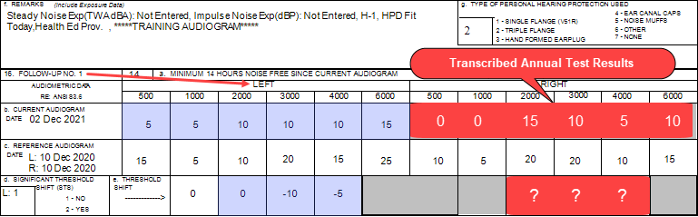
[SSN = 990990017] Confirm demographic fields 2 thru 14 (page 71)
Is there a change in hearing (ear specific)?
Are thresholds within the range of normal (ear specific)?
Where does the patient need to go?
Additional Comments?
Tri-Service Hearing Technician 4.2.0.0 Certification Course
Notes:
Do a brief review of counseling; have patient confirm their data in demographic fields 2 thru 14.
Is there a change in hearing? Negative STS Left ear initial 2216 test resolved
Are thresholds within the range of normal? Yes
Where does the patient need to go? Return in a year
Additional Comments
Have students write responses in their training booklet

Slide 33
Audiometric Testing and Follow-Up
Positive STS Follow-up Testing
Thresholds are worse than the reference
Requires 14 hazardous noise-free hours
Cannot be done the same day as the initial 2216 test
Follow-up 1 and Follow-up 2 should be accomplished on the same day (ear specific)
  If conductive issues (ENT) are suspected, refer to a medical provider prior to conducting further testing
Tri-Service Hearing Technician 4.2 Certification Course

Slide 34
Audiometric Testing and Follow-Up
Positive STS Follow-up Testing Scheduling
Time frames for Follow-up Testing from initial audiogram on the 2216
  30 days – all civilians and USAF Regular
  60 days – USAF Reserves and National Guard
  90 – All USA, USN, USMC military
Do not mention time frame for return to patients
Question them on the earliest they can return hazardous noise-free
Tri-Service Hearing Technician 4.2 Certification Course

Slide 35

Audiometric Testing and Follow-Up
Positive STS Follow-up Testing Resolved (TTS)
If the STS resolves on the Follow-up 1 (TTS after auditory rest) Follow-up 2 cannot be accomplished
  Counsel/Educate
  Refit HPDs (patient may not be wearing them properly or they are the wrong size)
  Return in a year
If the STS is still present on the Follow-up 1, complete a Follow-up 2 test
SSN = 990990018
Tri-Service Hearing Technician 4.2 Certification Course
Notes:
Student can look at data in their own database, viewing the 990990018 DD Form 2216 initial and follow-up tests in the edit audiogram window to observe/review
If an STS and an EWS are both present the STS takes precedence

Slide 36
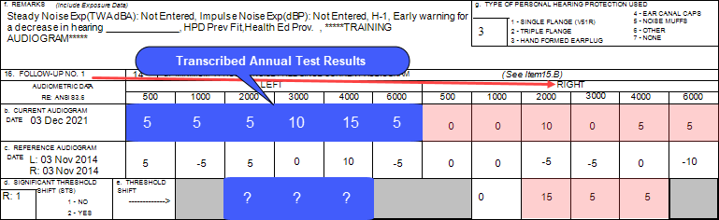
[SSN = 990990018] Confirm demographic fields 2 thru 14 (page 72)
Is there a change in hearing (ear specific)?
Are thresholds within the range of normal (ear specific)?
Where does the patient need to go?
Additional Comments?
Tri-Service Hearing Technician 4.2.0.0 Certification Course
Notes:
Do a brief review of counseling; have patient confirm their data in demographic fields 2 thru 14.
Is there a change in hearing? Positive STS Right ear on initial 2216 test; resolved on Follow-up test
Are thresholds within the range of normal? Yes; EWS right ear, sign 2216
Where does the patient need to go? Return in a year
Additional Comments
Have students write responses in their training booklet

Slide 37
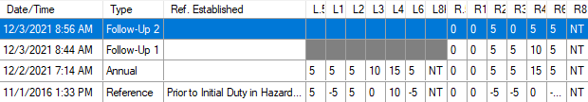
Audiometric Testing and Follow-Up
Positive STS Follow-up Testing Resolved (TTS)
Ensure to physically re-test the ear that the patient had an STS on
If the STS resolves on the Follow-up 2 (TTS after auditory rest)
  Counsel/Educate
  Refit HPDs (patient may not be wearing them properly or they are the wrong size)
  Return in a year
SSN = 990990015
Tri-Service Hearing Technician 4.2 Certification Course
Notes:
Student can look at data in their own database, viewing the 990990015 DD Form 2216 initial and follow-up tests in the edit audiogram window to observe/review
If an STS and an EWS are both present the STS takes precedence

Slide 38
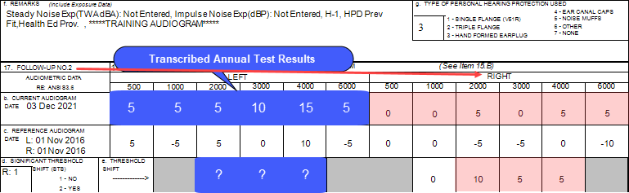
[SSN = 990990015] Confirm demographic fields 2 thru 14 (page 73)
Is there a change in hearing (ear specific)?
Are thresholds within the range of normal (ear specific)?
Where does the patient need to go?
Additional Comments?
Tri-Service Hearing Technician 4.2.0.0 Certification Course
Notes:
Do a brief review of counseling; have patient confirm their data in demographic fields 2 thru 14.
Is there a change in hearing? Positive STS Right ear on initial 2216/Follow-up 1 test; resolved on Follow-up 2 test
Are thresholds within the range of normal? Yes; EWS right ear, sign 2216
Where does the patient need to go? Return in a year
Additional Comments
Have students write responses in their training booklet

Slide 39
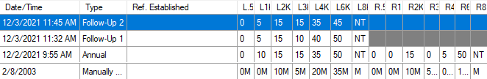
Audiometric Testing and Follow-Up
Positive STS Follow-up 2 Testing Confirmed
Ensure to physically re-test the ear that the patient had an STS on
If the STS is still present on the Follow-up 2 (PTS after reviewed and validated by Professional Supervisor in conjunction with re-establishing the baseline)
SSN = 990990016
Tri-Service Hearing Technician 4.2 Certification Course
Notes:
Student can look at data in their own database, viewing the 990990016 DD Form 2216 initial and follow-up tests in the edit audiogram window to observe/review

Slide 40
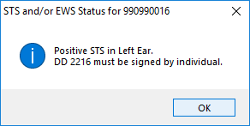
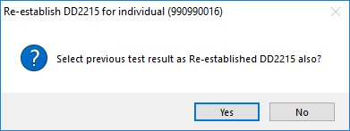
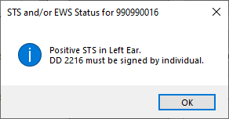
Audiometric Testing and Follow-Up
Positive STS Follow-up 2 Testing Confirmed
Application will ask if re-establishment using previous test results is requested
Always select “No”
Have patient sign the 2216
Tri-Service Hearing Technician 4.2 Certification Course
Notes:
Student can look at data in their own database, viewing the 990990016 DD Form 2216 initial and follow-up tests in the edit audiogram window to observe/review

Slide 41
Audiometric Testing and Follow-Up
Positive STS Follow-up 2 Testing Confirmed
Refer to the proper echelon of care (PS - Professional Supervisor) for evaluation and/or administrative processing
Only re-establish baselines
  With review/approval of the PS, follow-up test and/or audiological evaluation results may be used to create a DD Form 2215 (type 3) re-established reference
  Add an electronic remark on the DD Form 2215 with who (PS) authorized the baseline re-establishment or who manually entered the data
Tri-Service Hearing Technician 4.2 Certification Course
Notes:
Student can look at data in their own database, viewing the 990990016 DD Form 2216 initial and follow-up tests in the edit audiogram window to observe/review

Slide 42
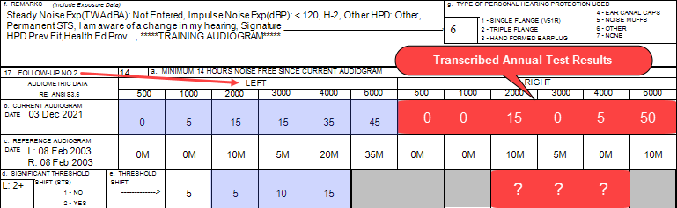
[SSN = 990990016] Confirm demographic fields 2 thru 14 (page 74)
Is there a change in hearing (ear specific)?
Are thresholds within the range of normal (ear specific)?
Where does the patient need to go?
Additional Comments?
Tri-Service Hearing Technician 4.2.0.0 Certification Course
Notes:
Do a brief review of counseling; have patient confirm their data in demographic fields 2 thru 14.
Is there a change in hearing? Positive STS Left ear on initial 2216/Follow-up 1 and 2 test
Are thresholds within the range of normal? No; sign 2216
Where does the patient need to go? Forward referral to PS for either administrative re-establishment or an evaluation
Additional Comments
Have students write responses in their training booklet

Slide 43
Audiometric Testing and Follow-Up
Non-Hearing Conservation Test
Performed on individuals who are not enrolled in the Hearing Program
  Physical, Pre-commissioning, Separation History and Physical Examination (SHPE), Non-DoD employees, Etc.
Performed on individuals requesting a hearing test before their periodic evaluation who are concerned about changes in hearing due to possible illness, medical condition, etc.
  Consult with Professional Supervisor to determine how these encounters should be handled
SHPE added as an electronic remark for military personnel who are leaving the service and may not have a DD Form 2215
Tri-Service Hearing Technician 4.2 Certification Course

Slide 44

Audiometric Testing and Follow-Up
Non-Hearing Conservation Test
  SSN = 990990005
  Normally all Service Members have a DD Form 2215
    Ensure Patient SSN is correct
  If there is not a reference audiogram you cannot do a 2216 (Termination)
    Select no to Hazardous Noise Exposed
    Select NHC Test
    Add electronic remark
Tri-Service Hearing Technician 4.2 Certification Course
Notes:
Student can look at data in their own database, viewing the 990990015 DD Form 2216 initial and follow-up tests in the edit audiogram window to observe/review

Slide 45
Audiometric Testing and Follow-Up
Non-Hearing Conservation Test
[SSN = 990990005] Confirm demographic fields 2 thru 14 (page 74)
Review audiogram with patient
Are thresholds within the range of normal (ear specific)?
Where does the patient need to go?
Additional Comments?
Tri-Service Hearing Technician 4.2.0.0 Certification Course
Notes:
Do a brief review of counseling; have patient confirm their data in demographic fields 2 thru 14.
Are thresholds within the range of normal? Yes
Where does the patient need to go?
Additional Comments
Have students write responses in their training booklet

Slide 46
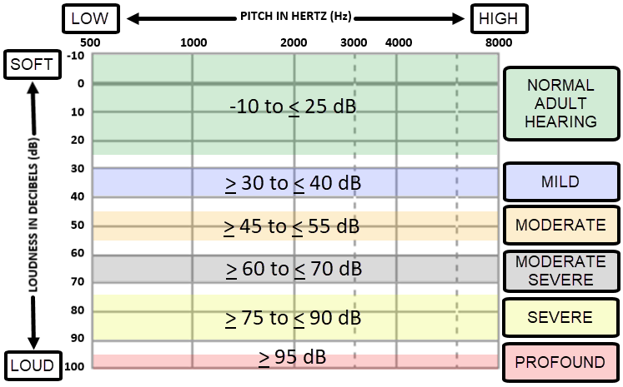
Audiometric Testing and Follow-Up
Degree of Hearing Loss
Tri-Service Hearing Technician 4.2 Certification Course
Notes:
Graphic created by USN

Slide 47
Audiometric Testing and Follow-Up
Post Audiometric Testing Review
Technician is required to counsel patient on results
  Early warning shift (EWS)
  Change in hearing, Significant/Standard Threshold Shift (STS)
  Return for follow-up testing
Process automated referrals
Create referrals for conductive or other issues
  Physician
  Audiologist
Tri-Service Hearing Technician 4.2 Certification Course

Slide 48
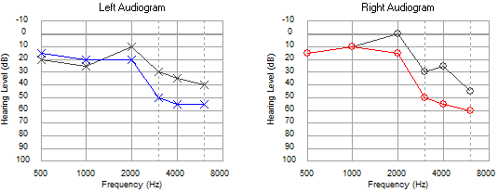
Audiometric Testing and Follow-Up
Audiometric Configurations
Sloping High Frequency Hearing Loss
SSN = 990990042 (Annual Test)
Tri-Service Hearing Technician 4.2 Certification Course
Notes:
Most common audiometric configuration
Associated with aging (Presbycusis), ototoxicity, diseases (meningitis, measles), and can be congenital
Audiogram in local database under 990990042

Slide 49
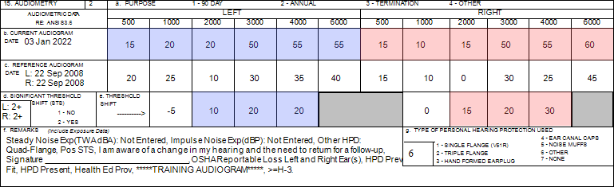
[SSN = 990990042] Confirm demographic fields 2 thru 14 (page 76)
Is there a change in hearing (ear specific)?
Are thresholds within the range of normal (ear specific)?
Where does the patient need to go?
Additional Comments?
Tri-Service Hearing Technician 4.2.0.0 Certification Course
Notes:
Do a brief review of counseling; have patient confirm their data in demographic fields 2 thru 14.
Is there a change in hearing? STS Both ears, patient needs to sign DD Form 2216
Are thresholds within the range of normal? No, Moderate Hearing Loss Left ear; Moderate Severe Hearing Loss Right ear
Where does the patient need to go? Return for follow-up testing
Additional Comments
Have students write responses in their training booklet

Slide 50
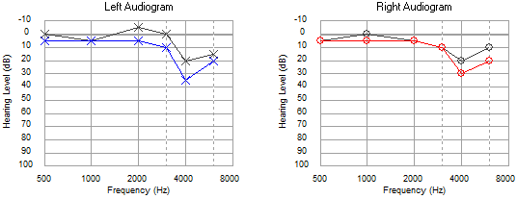
Audiometric Testing and Follow-Up
Audiometric Configurations
Sloping High Frequency Hearing Loss - Noise Notch
SSN = 990990007
Tri-Service Hearing Technician 4.2 Certification Course
Notes:
Noise Notch often first observed at 4000 Hz, but could begin at 3000 Hz or 6000 Hz; Hearing loss spreads to adjacent frequencies as noise exposure continues
Audiogram in local database under 990990007

Slide 51
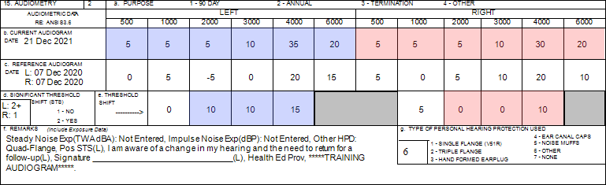
[SSN = 990990007] Confirm demographic fields 2 thru 14 (page 77)
Is there a change in hearing (ear specific)?
Are thresholds within the range of normal (ear specific)?
Where does the patient need to go?
Additional Comments?
Tri-Service Hearing Technician 4.2.0.0 Certification Course
Notes:
Do a brief review of counseling; have patient confirm their data in demographic fields 2 thru 14.
Is there a change in hearing? STS left ear, patient needs to sign DD Form 2216; noise notch
Are thresholds within the range of normal? No, Mild Hearing Loss
Where does the patient need to go? Return for follow-up testing
Additional Comments
Have students write responses in their training booklet

Slide 52
Audiometric Testing and Follow-Up
Audiogram Considerations Fitness for Duty
Profile Change (Service Specific USN/USMC) [SSN = 990990042 - Follow-up 2]
Hearing loss in both ears in which the sum of thresholds at 3000 Hz, 4000 Hz, and 6000 Hz > 270 dB (USN/USMC use 270 rule)
Has their DD 2215 re-established 3 times
Should not be assigned to duties involving exposure to hazardous noise until evaluated and waived by an audiologist, otologist, or occupational medicine physician
Tri-Service Hearing Technician 4.2 Certification Course

Slide 53
Audiometric Testing and Follow-Up
Audiometric Configurations
Fitness for duty (270 dB)
SSN = 990990042 (Follow-up 2)
Tri-Service Hearing Technician 4.2 Certification Course
Notes:
Audiogram in local database under 990990042

Slide 54
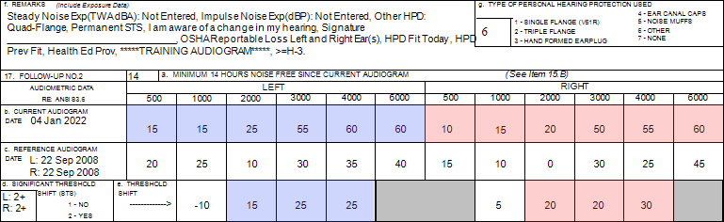
[SSN = 990990042] Confirm demographic fields 2 thru 14 (page 78)
Is there a change in hearing (ear specific)?
Are thresholds within the range of normal (ear specific)?
Where does the patient need to go?
Additional Comments?
Tri-Service Hearing Technician 4.2.0.0 Certification Course
Notes:
Do a brief review of counseling; have patient confirm their data in demographic fields 2 thru 14.
Is there a change in hearing? STS Both ears, patient needs to sign DD Form 2216
Are thresholds within the range of normal? No, Moderate Severe Hearing Loss Both ears
Where does the patient need to go? Forward to PS for evaluation
Additional Comments Meets 270 rule
May have comment: No longer fit to work in noise UNLESS cleared by an Occ Med Provider or Audiologist
Have students write responses in their training booklet

Slide 55
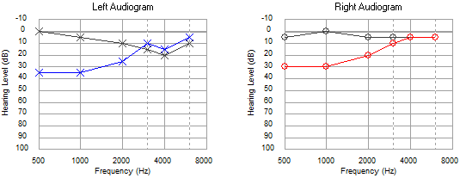
Audiometric Testing and Follow-Up
Audiometric Configurations
Rising Low Frequency Hearing Loss
SSN = 990990009
Tri-Service Hearing Technician 4.2 Certification Course
Notes:
Can be caused by ear disease or middle ear dysfunction (Conductive issues - Otoscopic Exam)
Audiogram in local database under 990990009, 2215 (Created a Low Frequency Hearing Loss Referral) and 2216 (no referral)
Technician should never establish or re-establish baseline until conductive issues are resolved

Slide 56
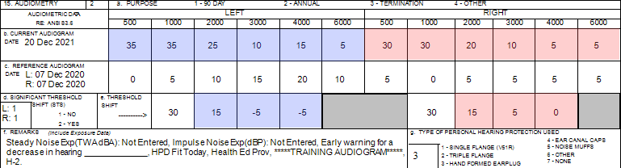
[SSN = 990990009] Confirm demographic fields 2 thru 14 (page 79)
Is there a change in hearing (ear specific)?
Are thresholds within the range of normal (ear specific)?
Where does the patient need to go?
Additional Comments?
Tri-Service Hearing Technician 4.2.0.0 Certification Course
Notes:
Do a brief review of counseling; have patient confirm their data in demographic fields 2 thru 14.
Is there a change in hearing? No
Are thresholds within the range of normal? No, Mild Hearing Loss
Where does the patient need to go? Do otoscopic exam; refer to PCM and/or Physician; Return in a year
Additional Comments
Have students write responses in their training booklet

Slide 57
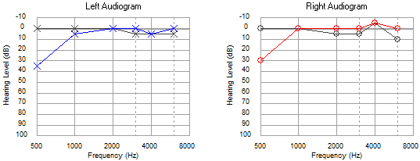
Audiometric Testing and Follow-Up
Audiometric Configurations
Rising Low Frequency Hearing Loss
SSN = 990990008
Tri-Service Hearing Technician 4.2 Certification Course
Notes:
Can occur as a result of background noise; 500 Hz threshold will often be elevated in these instances
Audiogram in local database under 990990008

Slide 58
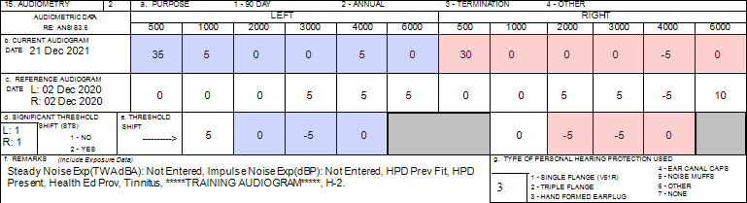
[SSN = 990990008] Confirm demographic fields 2 thru 14 (page 80)
Is there a change in hearing (ear specific)?
Are thresholds within the range of normal (ear specific)?
Where does the patient need to go?
Additional Comments?
Tri-Service Hearing Technician 4.2.0.0 Certification Course
Notes:
Do a brief review of counseling; have patient confirm their data in demographic fields 2 thru 14.
Is there a change in hearing? No
Are thresholds within the range of normal? No, Mild Hearing Loss
Where does the patient need to go? Return in a year
Additional Comments
Have students write responses in their training booklet

Slide 59
Audiometric Testing and Follow-Up
Audiogram Considerations
Problem Audiograms – Masking
Required if the difference between ears is > 40 dB at one or multiple frequencies
Performed during diagnostic (audiologist) hearing evaluation when cross-over is suspected
Masking noise (static) presented in the non-test ear while thresholds are being recorded for test ear to prevent cross-over
Prevents the non-test ear from detecting the sound presented to the test ear
DOEHRS-HC will generate a referral if masking is required
Follow PS guidance on automated referrals for masking
Tri-Service Hearing Technician 4.2 Certification Course

Slide 60
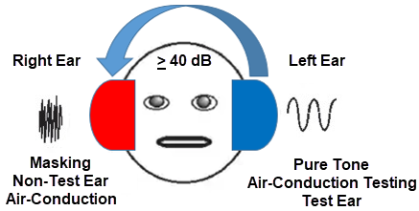
Audiometric Testing and Follow-Up
Masking
Right ear threshold at 1000 Hz: 20 dB
Left ear threshold at 1000 Hz: 70 dB
In this example: masking/static noise is presented to the right ear at the same time pure tones are presented to the left ear; this is to prevent the right ear from hearing the pure tones.
Tri-Service Hearing Technician 4.2 Certification Course
Notes:
Masking noise is required if there is a greater or equal to 40 dB HL difference between ears at any given frequency.
Masking noise = static noise presented to the ear with the better/lower threshold at any given frequency.
Example: 1000 Hz in the right ear is 20 dB HL while 1000 Hz in the left ear is 70 dB HL. Is this a difference of greater than/equal to 40 dB? Yes, the difference is 50 dB HL. Masking noise is presented to the right ear to prevent the pure tone presentation in the left ear from “crossing over” to the right ear; therefore, getting an accurate threshold in the left ear.
Photo: https://entokey.com/audiometric-testing/
Adapted from: Roeser, R. J., & Clark, J. L. (2007). Clinical masking. In R. J. Roeser, M. Valente, & H. Hosford-Dunn (Eds.). Audiology: Diagnosis. 2nd ed. (pp. 261–287). New York: Thieme Medical Publishers, Inc.

Slide 61
Audiometric Testing and Follow-Up
Audiogram Considerations
Problem Audiograms – Cross Over
Can occur when a ≥ 40 dB difference in thresholds exists between ears at one or more frequency(s)
Sound energy from the test ear stimulates the non-test ear causing non-test ear to respond to the stimulus
DOEHRS-HC performs an automatic re-check when threshold difference is ≥ 40 dB between ears at a given frequency
If difference confirmed, DOEHRS-HC will generate a Masking referral
Tri-Service Hearing Technician 4.2 Certification Course

Slide 62
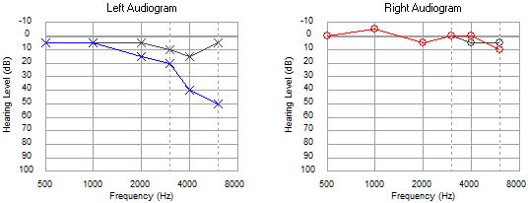
Audiometric Testing and Follow-Up
Audiometric Configurations
Unilateral High Frequency Hearing Loss
SSN = 990990010
Tri-Service Hearing Technician 4.2 Certification Course
Notes:
Audiogram in local database under 990990010

Slide 63
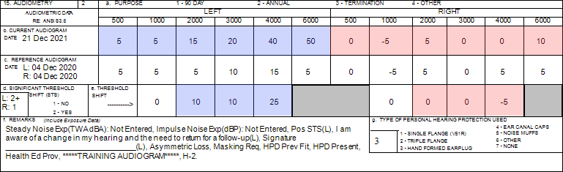
[SSN = 990990010] Confirm demographic fields 2 thru 14 (page 82)
Is there a change in hearing (ear specific)?
Are thresholds within the range of normal (ear specific)?
Where does the patient need to go?
Additional Comments?
Tri-Service Hearing Technician 4.2.0.0 Certification Course
Notes:
Do a brief review of counseling; have patient confirm their data in demographic fields 2 thru 14.
Is there a change in hearing? Yes
Are thresholds within the range of normal? No, Moderate Hearing Loss Left ear
Where does the patient need to go? Return for follow-up testing, if Asymmetry/Masking and/or STS persists refer/bring to PS attention
Additional Comments
Have students write responses in their training booklet

Slide 64
Audiometric Testing and Follow-Up
Audiogram Considerations
Problem Audiograms – Asymmetry
DOEHRS-HC will trigger an Asymmetric Hearing Loss referral if two consecutive frequencies between ears have a difference of 25dB or more
Thresholds in one ear are better than thresholds in the opposite ear
May be associated with noise exposure, sudden SNHL, or acoustic neuroma/vestibular schwannoma
Always considered a problem audiogram
Audiogram should always be reviewed by the Professional Supervisor
Tri-Service Hearing Technician 4.2 Certification Course

Slide 65
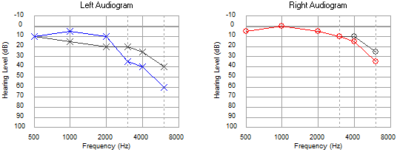
Audiometric Testing and Follow-Up
Audiometric Configurations
Asymmetrical Hearing Loss
SSN = 990990011
Tri-Service Hearing Technician 4.2 Certification Course
Notes:
Audiogram in local database under 990990011

Slide 66
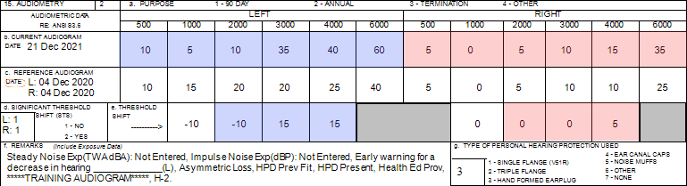
[SSN = 990990011] Confirm demographic fields 2 thru 14 (page 83)
Is there a change in hearing (ear specific)?
Are thresholds within the range of normal (ear specific)?
Where does the patient need to go?
Additional Comments?
Tri-Service Hearing Technician 4.2.0.0 Certification Course
Notes:
Do a brief review of counseling; have patient confirm their data in demographic fields 2 thru 14.
Is there a change in hearing? No
Are thresholds within the range of normal? No, Moderate Severe Hearing Loss Left ear; Mild Hearing Loss Right ear
Where does the patient need to go? Refer/bring to PS attention
Additional Comments
Have students write responses in their training booklet

Slide 67
Audiometric Testing and Follow-Up
Audiogram Considerations
Problem Audiograms – Function and/or Non-Organic Hearing Loss
Lack of crossover (large difference between ears)
Flat audiogram
Inconsistent responses
Behavior
Known motivation
50 dB or above
Tri-Service Hearing Technician 4.2 Certification Course
Notes:
Crossover occurs around 40-45 dB; lack of cross over patient may have a much higher variance between ears

Slide 68
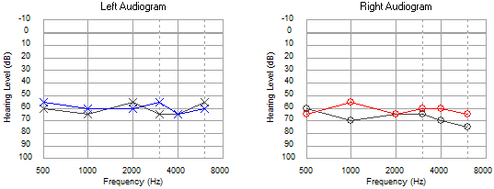
Audiometric Testing and Follow-Up
Audiometric Configurations
Flat Hearing Loss
SSN = 990990019
Tri-Service Hearing Technician 4.2 Certification Course
Notes:
Audiogram in local database under 990990019

Slide 69
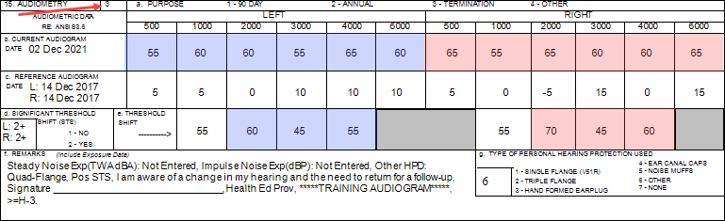
[SSN = 990990019] Confirm demographic fields 2 thru 14 (page 84)
Is there a change in hearing (ear specific)?
Are thresholds within the range of normal (ear specific)?
Where does the patient need to go?
Additional Comments?
Tri-Service Hearing Technician 4.2.0.0 Certification Course
Notes:
Do a brief review of counseling; have patient confirm their data in demographic fields 2 thru 14.
Is there a change in hearing? Yes
Are thresholds within the range of normal? No, Moderate Severe Hearing Loss Both ears
Where does the patient need to go? Return for Follow-up testing
Additional Comments
Have students write responses in their training booklet

Slide 70
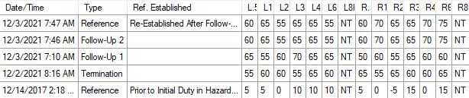
Audiometric Testing and Follow-Up
Audiogram Considerations
SSN = 990990019
Patient returned for Follow-up testing
What should occur after Follow-up 2?
Tri-Service Hearing Technician 4.2 Certification Course
Notes:
Remind students to not re-establish the baseline

Slide 71
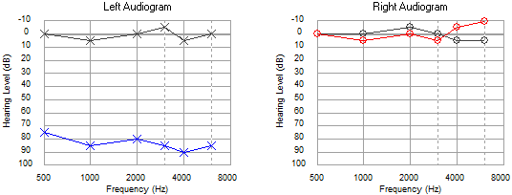
Audiometric Testing and Follow-Up
Audiometric Configurations
Asymmetrical Flat Hearing Loss
SSN = 990990013
Tri-Service Hearing Technician 4.2 Certification Course
Notes:
Audiogram in local database under 990990013

Slide 72
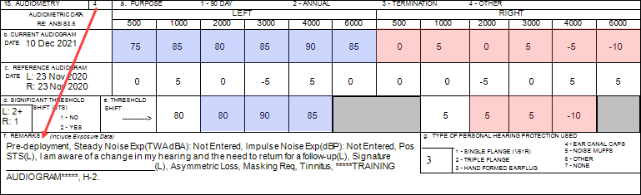
[SSN = 990990013] Confirm demographic fields 2 thru 14 (page 85)
Is there a change in hearing (ear specific)?
Are thresholds within the range of normal (ear specific)?
Where does the patient need to go?
Additional Comments?
Tri-Service Hearing Technician 4.2.0.0 Certification Course
Notes:
Do a brief review of counseling; have patient confirm their data in demographic fields 2 thru 14.
Is there a change in hearing? Yes
Are thresholds within the range of normal? No, Severe Hearing Loss Left ear; Right ear normal
Where does the patient need to go? Return for Follow-up testing
Additional Comments
Have students write responses in their training booklet

Slide 73
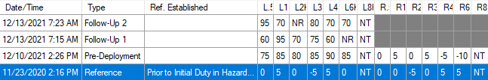
Audiometric Testing and Follow-Up
Audiogram Considerations
SSN = 990990013
Patient returned for Follow-up testing
What should occur after Follow-up 2?
Tri-Service Hearing Technician 4.2 Certification Course

Slide 74

Audiometric Testing and Follow-Up
Audiometric Configurations
Sudden Hearing Loss – Always a Medical Emergency
SSN = 990990026
Tri-Service Hearing Technician 4.2 Certification Course
Notes:
Audiogram in local database under 990990013

Slide 75

[SSN = 990990026] Confirm demographic fields 2 thru 14 (page 86)
Is there a change in hearing (ear specific)?
Are thresholds within the range of normal (ear specific)?
Where does the patient need to go?
Additional Comments?
Tri-Service Hearing Technician 4.2.0.0 Certification Course
Notes:
Do a brief review of counseling; have patient confirm their data in demographic fields 2 thru 14.
Is there a change in hearing? Yes
Are thresholds within the range of normal? No, Severe Hearing Loss Left ear; Right ear Mild Hearing Loss
Where does the patient need to go? Call PS, refer immediately
Additional Comments
Have students write responses in their training booklet

Slide 76
Audiometric Testing and Follow-Up
Audiogram Referrals
DOEHRS-HC referral flags - some are listed below
  Positive STS - conduct Follow-up testing
  Asymmetrical hearing loss
  Low and/or high frequency hearing loss
  Masking
  Tinnitus
  Fitness and Risk Evaluation
Review the audiometric history to determine what happened and what needs to occur
Tri-Service Hearing Technician 4.2 Certification Course

Slide 77
Audiometric Testing and Follow-Up
Audiogram Referrals
DOEHRS-HC may not create a referral but further examinations/care may need to occur
  Fitness for Duty; Profile change; Conductive issues on a 2216
Conductive issues suspected - do an otoscopic examination and/or refer for evaluation/care
  If Follow-up testing is required, delay until conductive issues are resolved
Tri-Service Hearing Technician 4.2 Certification Course

Slide 78
Audiometric Testing and Follow-Up
Profile Change
Pertains to military personnel only
Profile change does not auto generate a referral
  Service Specific
Review the audiometric history
  Determine if patient was previously evaluated
  Refer to an audiologist if needed
Tri-Service Hearing Technician 4.2 Certification Course

Slide 79
Audiometric Testing and Follow-Up
USA/USAF Physical Profile Serial System (PULHES)
P = Physical capacity/stamina
U = Upper body
L = Lower body
H = Hearing and ears
  Focused on hearing and any diseases of the ear
E = Eyes
S = Stability/Psychiatric
Tri-Service Hearing Technician 4.2 Certification Course

Slide 80
Audiometric Testing and Follow-Up
PULHES Numerical Grade System
1 = a high level of medical fitness; fully ​qualified
2 = possesses some medical condition or physical defect that may require some activity limitations
3 = one or more medical conditions or physical defects that may require significant limitations; may still be able to stay in the military with limited duties
4 = one or more medical conditions or physical defects of such severity that the performance of military duty must be drastically limited; disqualifier for continued military service
Tri-Service Hearing Technician 4.2 Certification Course

Slide 81
Audiometric Testing and Follow-Up
PULHES “H”
DOEHRS-HC test is not a diagnostic hearing test, a profile should not be created from this test alone
DOEHRS-HC tests indicate projected profiles
If a DOEHRS-HC test projects a profile of > H2, a referral for a diagnostic hearing evaluation is necessary (check audiometric history)
Hearing profiles will be documented IAW Service specific guidelines
Tri-Service Hearing Technician 4.2 Certification Course

Slide 82

Audiometric Testing and Follow-Up
Audiometric Considerations
Profile Change (Service Specific - USA/USAF) [SSN = 990990023]
Any Profile changes are required to be evaluated/verified by PS
Tri-Service Hearing Technician 4.2 Certification Course
Notes:
Audiogram in local database under 990990023

Slide 83

[SSN = 990990023] Confirm demographic fields 2 thru 14 (page 88)
Is there a change in hearing (ear specific)?
Are thresholds within the range of normal (ear specific)?
Where does the patient need to go?
Additional Comments?
Tri-Service Hearing Technician 4.2.0.0 Certification Course
Notes:
Do a brief review of counseling; have patient confirm their data in demographic fields 2 thru 14.
Is there a change in hearing? No; there is a EWS
Are thresholds within the range of normal? No, Mild Hearing Loss left ear
Where does the patient need to go? Do an otoscopic exam, if abnormal have conductive issues resolved bring back for another Annual test; if conductive issues not suspected, refer to audiologist for evaluation
Additional Comments
Have students write responses in their training booklet

Slide 84
Audiometric Testing and Follow-up
Summary
Graphic/Serial audiogram
Patient demographic
Audiograms types
  DD Form 2215
  DD Form 2216 including Follow-up testing
  Non-Hearing Conservation test
Audiometric configurations
Problem Audiograms
Baseline re-establishment
Tri-Service Hearing Technician 4.2.0.0 Certification Course

Slide 85
Audiometric Testing and Follow-up
? Questions ?
Tri-Service Hearing Technician
4.2 Certification Course

